Slide 1
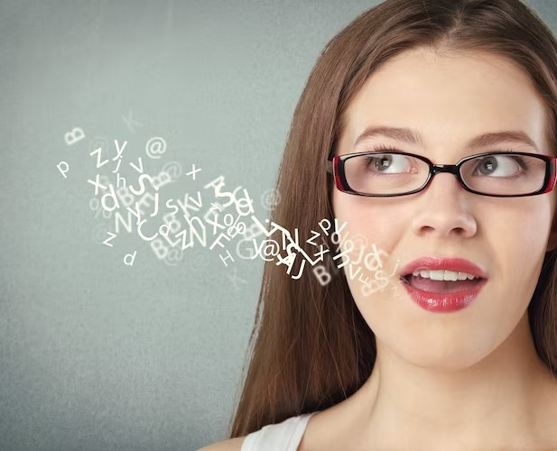
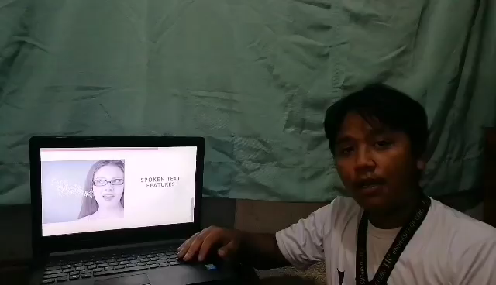
SPOKEN TEXT FEATURES

Slide 2
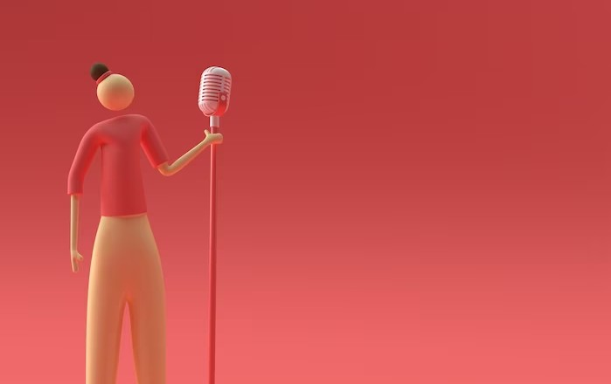
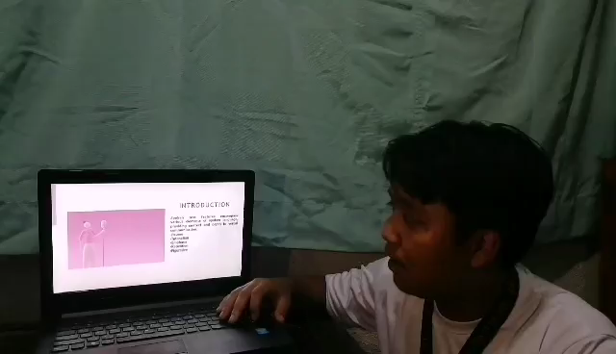
INTRODUCTION
Spoken text features encompass various elements of spoken language, providing context and depth to verbal communication.
-Pauses
-Intonation
-Emphasis
-Repetition
-Figurative

Slide 3


PAUSES
Pauses in spoken text create rhythm, emphasize key points, and allow audience processing. In IT podcasts or audiobooks, they're used before or after technical terms or complex concepts, for dramatic effect, or to signal content transitions.

Slide 4
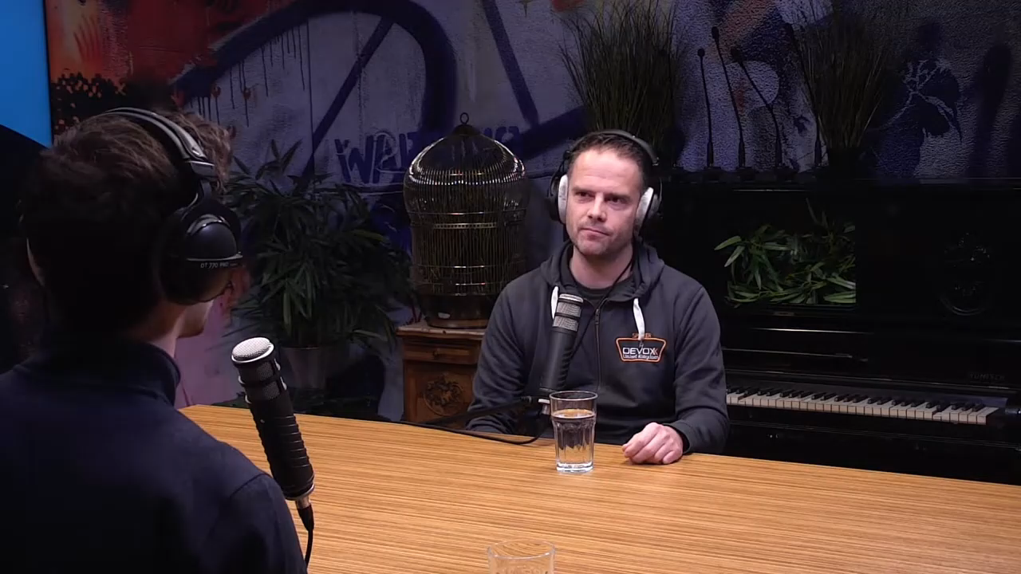
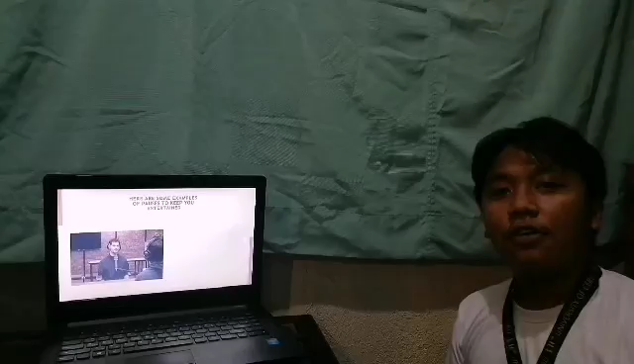
HERE ARE SOME EXAMPLES OF PAUSES TO KEEP YOU ENTERTAINED

Slide 5
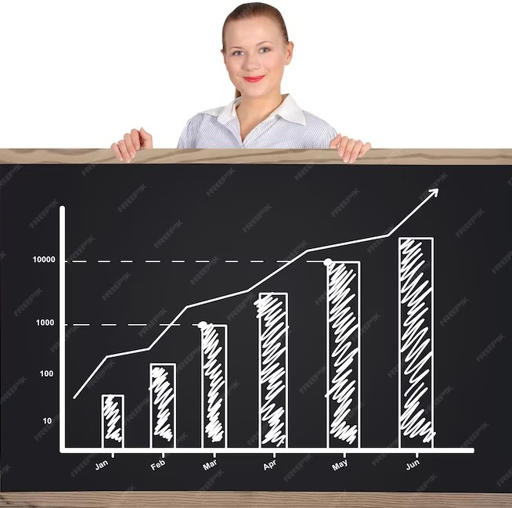

INTONATION
Intonation in IT discussions conveys the speaker's attitude, mood, and intended meaning. Rising intonation indicates curiosity, while falling intonation signifies authority. It signals the importance of ideas and engages the audience.

Slide 6
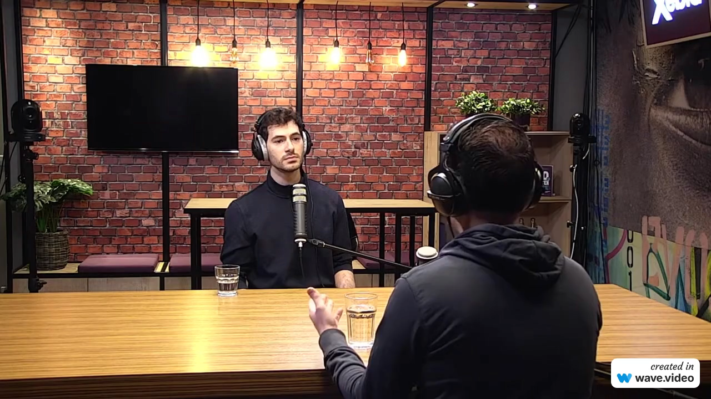

HERER ARE SOME EXAMPLES OF INTONATION TO KEEP YOU ENTERTAINED

Slide 7
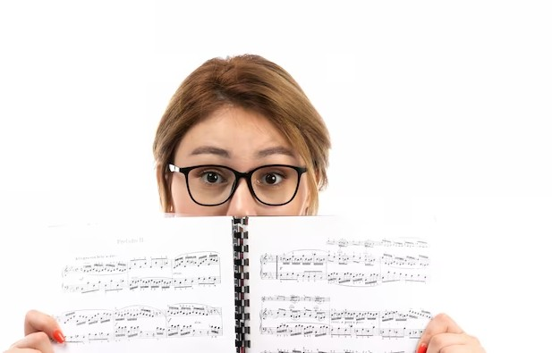

EMPHASIS
In IT discussions, speakers can emphasize key terms, concepts, or warnings by changing volume, tone, or pace. For example, the word "security" can be pronounced sharper and slower to emphasize its importance in data protection.

Slide 8
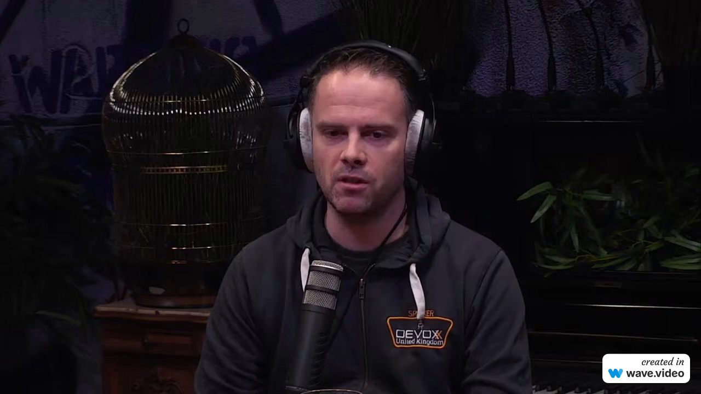

HERE ARE SOME EXAMPLES OF EMPHASIS TO KEEP YOU ENTERTAINED

Slide 9
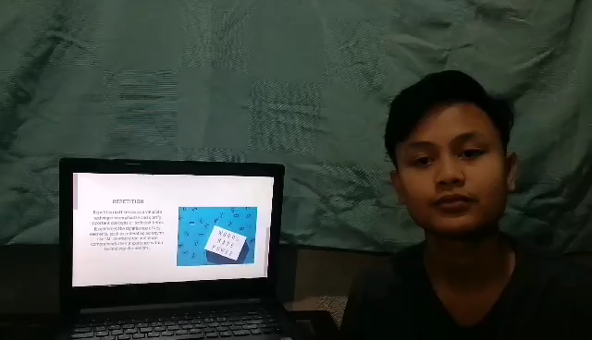
REPETITION
Repetition in IT serves as a valuable technique to emphasize and clarify important concepts or technical terms.
It reinforces the significance of key elements, such as reiterating acronyms like "AI" to ensure the audience comprehends their importance within
technology discussions.

Slide 10
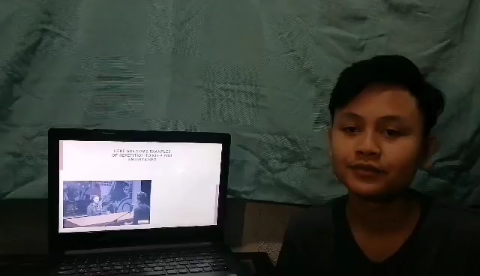
HERE ARE SOME EXAMPLES OF REPETITION TO KEEP YOU ENTERTAINED

Slide 11
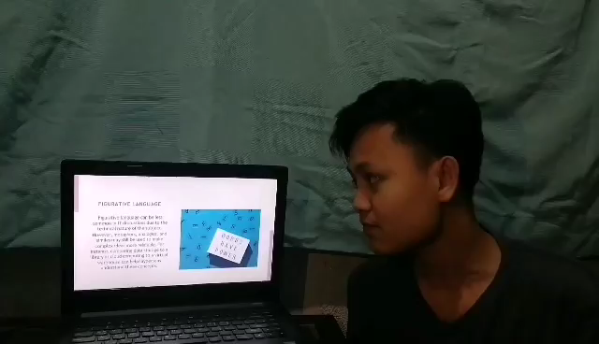
FIGURATIVE LANGUAGE
Figurative language can be less common in IT discussions due to the technical nature of the subject.
However, metaphors, analogies, and similes may still be used to make complex ideas more relatable.

Slide 12
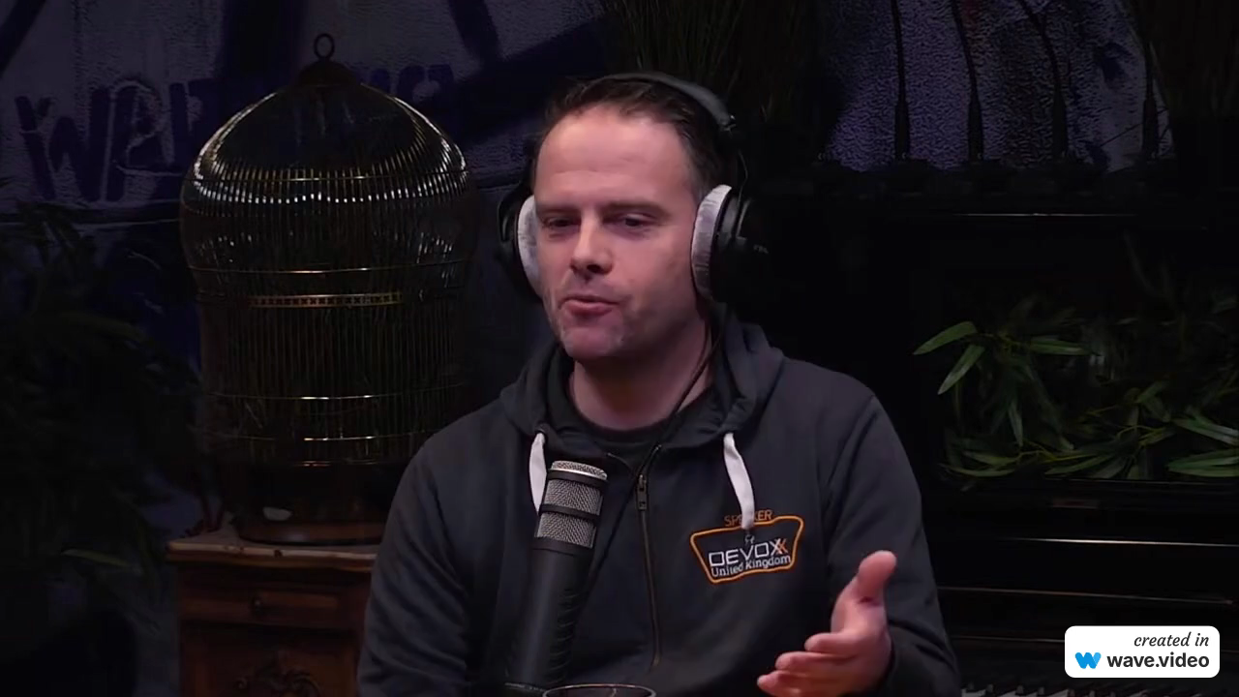

HERE ARE SOME EXAMPLES OF FIGURATIVE LANGUAGE TO KEEP YOU ENTERTAINED

Slide 13
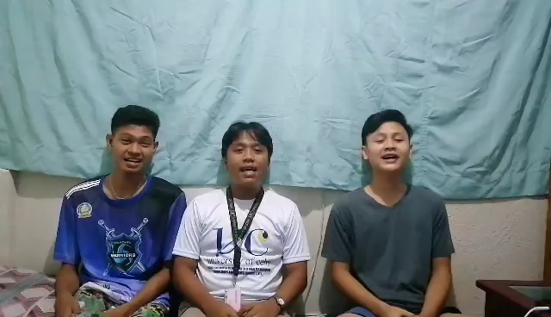
Thanks!

